Slide 1
Halloween and its history

Slide 2
Halloween
Halloween— the modern holiday which is going back to traditions of ancient Celts of Ireland and Scotland which history has begun in the territory of modern Great Britain and Northern Ireland. It is noted on October 31, on the eve of All Saints' Day.
In the night of October 31 for November 1 in the USA and Canada Halloween — the ancient Celtic holiday called also by the eve of All Saints' Day is marked out. Recently the holiday became popular also in Europe and Russia.

Slide 3
Halloween — history of emergence, a legend and tradition
Presently it is considered that the holiday Halloween symbolizes itself a life victory over death, in this regard people also change clothes in terrible suits, so to speak, to frighten death, that is show all a look that death aren't afraid.
At the time of paganism when year was divided into winter and summer — this day was considered as sacral. Celts considered that their chief Sun God, is taken prisoner since November 1 for all winter period to the Prince of Darkness and the chief lord of a kingdom of the dead — to Samkheyn.

Slide 4
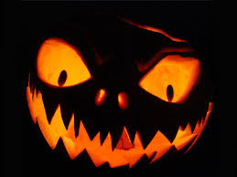
Halloween symbols
It is known that "Jack-o-lantern" represents the main symbol of a holiday. At the heart of a symbol pumpkin in which cut out the ominous and grinning person is pledged. Place the lit candle in inside pumpkins. Originally, instead of pumpkin the swede or turnip was used. According to legends, the pumpkin with a candle delivered near the house for Halloween drives away from it evil spirits.

Slide 5
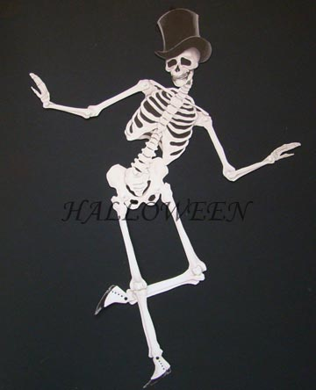
Music
As well as other holidays, at Halloween have famous songs and thematic music. Widely famous song "Monster Mash" of the pop-musician Bobbie Pikett became, according to a number of musical critics, a peculiar anthem of Halloween. Other very popular song is the composition of "This Is Halloween" written by Danny Elfman and which has entered a soundtrack to the animation movie the Nightmare before Christmas. She has repeatedly been rehashed by different not only American, but also Japanese performers

Slide 6
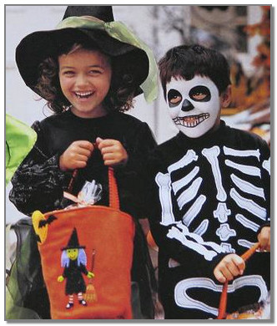
Traditions of Halloween
Suits
Vestments in carnival costumes — rather recently arisen holiday element. For the first time as full-fledged custom it was recorded at the beginning of the 20th century and goes back to the American traditions of fancy-dress parties. For the first time wearing fancy dresses for Halloween is registered in 1895 in Scotland when children walked in masks on houses and received candies, cakes, fruit and money. There is no mention of similar traditions in the USA, Ireland or England till 1900.

Slide 7
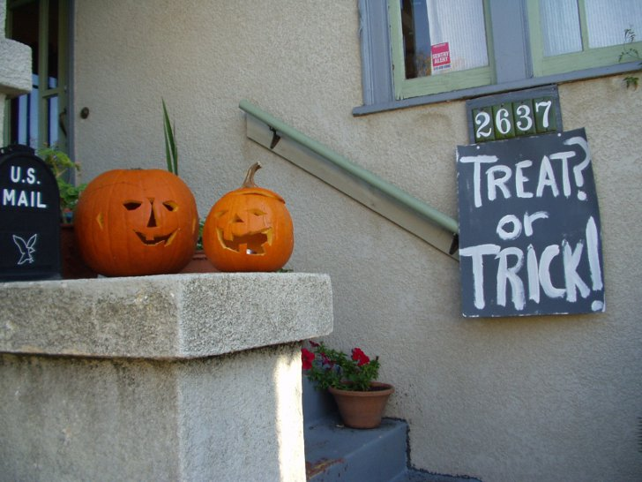
Trick-or-treat
. The term Trick-or-treat for the first time began to be used to the USA, the first time his use is recorded in 1934, and he has begun to extend actively only since 1939. The name can be translated as a joke or an entertainment that indicates comic threat to do harm if the owner doesn't bring to children an entertainment

Slide 8
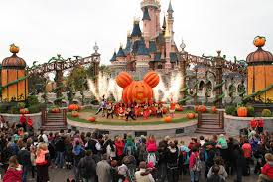
Аttractions
Important tradition of celebration of Halloween is the organization of so-called Haunted attractions which main goal — it is pleasant to frighten visitors. The "Orton and Spuner's house inhabited by ghosts" opened in 1915 is considered the oldest similar attraction

Slide 9
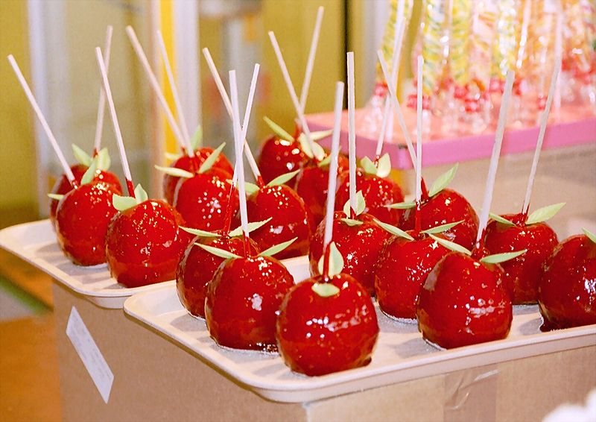
Holiday table
As the holiday falls on time of a harvest of apples, the majority of Halloween sweets is based on apples. Specially cook apple caramel, apples in syrup for a celebration (sometimes with addition of nuts), apple toffees. At first there was a tradition to distribute to children apples candies, but it quickly came to naught because of a city legend which said that in similar candies angry people put pins and needles.

Slide 10
The celebration of Halloween in the world and regional differences
After Halloween began to be marked out actively since the 19th century in the USA and Canada, he extended thanks to influence of the American culture worldwide, at the same time there is a number of regional distinctions. For example, in Ireland it is accepted to arrange large-scale pyrotechnic actions and fires, and in Scotland this custom is absent
Halloween in Russia
For Russia Halloween exotic and ambiguous holiday. According to sociological polls of Levada Center, four of five interviewed Russians know about a holiday, but only one of twenty respondents plans to celebrate it. The situation gradually changes, there are shops selling suits for Halloween, and its celebration is included into the schedule of shopping centers and night clubs.

Slide 11
Happy Halloween!!
Thanks for attention!!!

