Slide 1
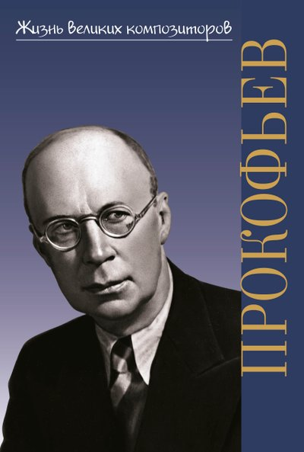
The Musical Genius - Sergey Prokofiev
(dedicated to the 705th anniversary of Sergey Prokofiev)
2026

Slide 2
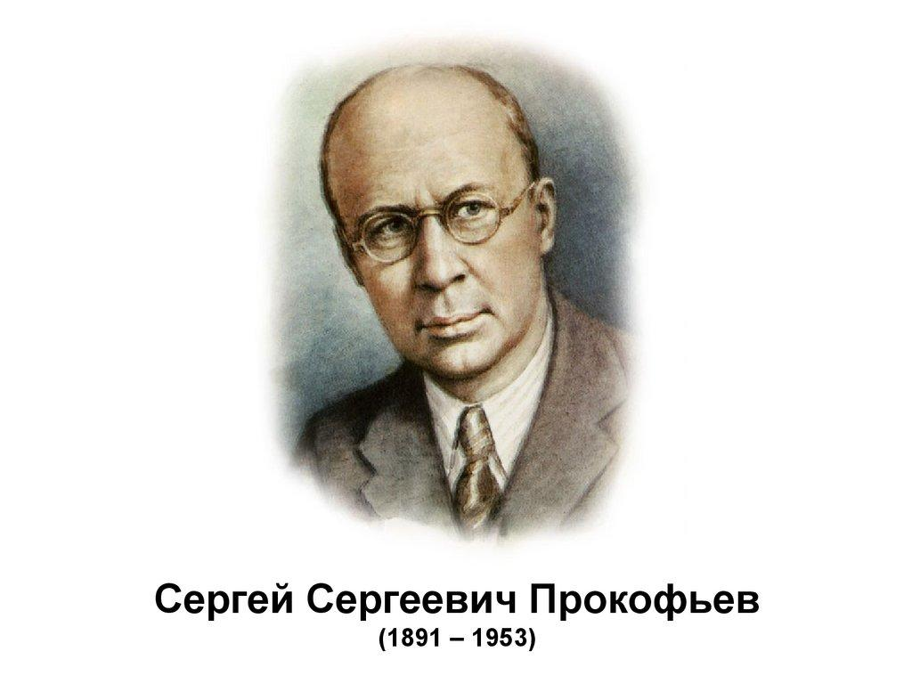
«Prokofiev was a genius who created his own musical language» /D.Shostakovich/

Slide 3
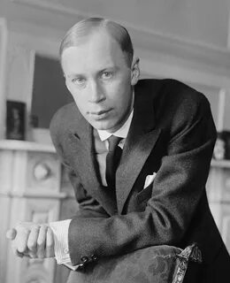
The Maestro of Musical Magic
Sergey Prokofiev was one of the most outstanding composers of the 20th century. His music continuous to inspire people around the world.

Slide 4
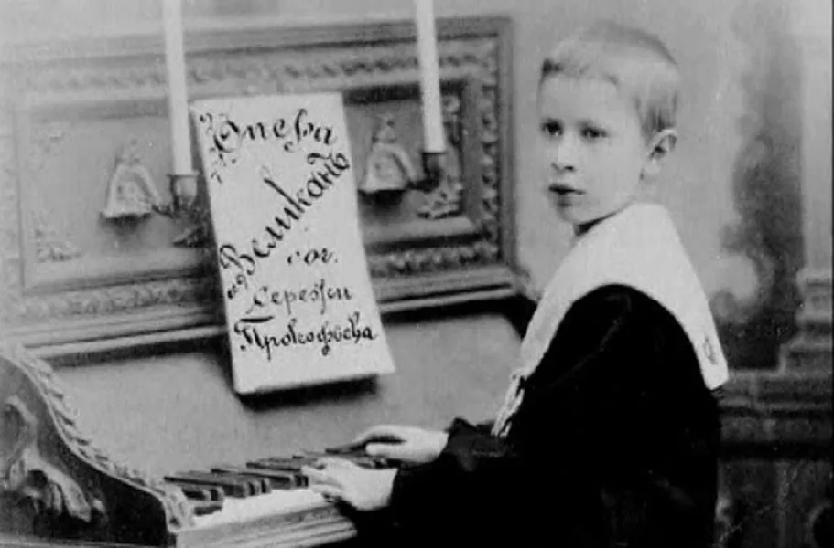
The Spark of Genius:
Early Years
Sergey Prokofiev was born on April 23, 1891, in the village of Sontsovka, Ukraine. His mother, a talented pianist, introduced him to music at an early age. Prokofiev showed extraordinary musical abilities from childhood. By the age of 5, he began composing, and at 9, he wrote his first opera.

Slide 5

The Path to Mastery
Prokofiev’s musical education began at home and continued at the Saint Petersburg Conservatory. There he studied under the guidance of the famous composer Nikolai Rimsky-Korsakov. He graduated with two degrees – as a composer in 1909 and as a pianist in 1914.

Slide 6
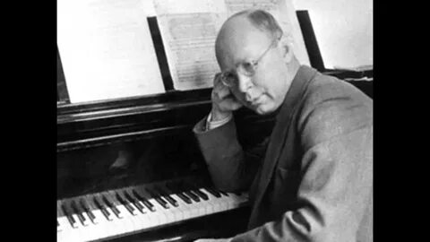
The Symphony of Life
Prokofiev’s creative path was remarkable. He worked in various musical genres, creating masterpieces in each of them. His works include operas, ballets, symphonies, concertos and chamber music.

Slide 7
Echoes of Genius: Musical Characters from Prokofiev’s Treasury
Masterpieces:
A Musical Treasury
The Sound of Innovation
Among his famous works are:
The ballet «Romeo and Juliet»;
The cantata «Alexander Nevsky»;
The symphonic fairy tale «Peter and the Wolf»;
The opera «War and Peace»;
7 symphonies.
Prokofiev developed his own distinctive musical style characterized by:
bright melodic lines;
innovative harmonies;
energetic rhythms;
dramatic contrasts;
original orchestration.

Slide 8
Beyond the Notes:
The Man Behind the Music
Prokofiev was an avid chess player;
He spoke several languages fluently;
He traveled extensively around the world;
Prokofiev created more than 130 musical compositions;
He was awarded the Lenin Prize and Stalin Prizes.

Slide 9
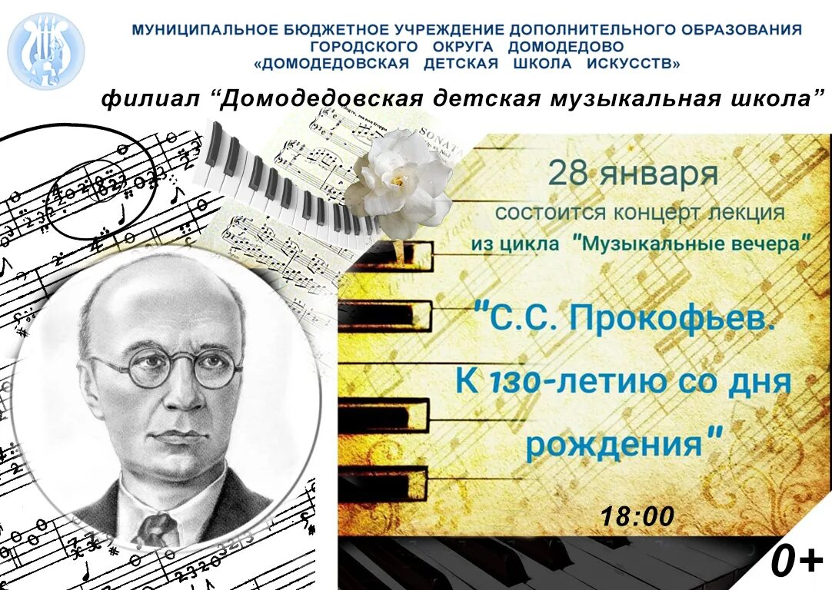
The Maestro’s Playground
Despite his busy creative schedule, Prokofiev found time for hobby. He was particularly passionate about chess, often playing with friends and colleagues. This logical thinking skill helped him in composing music.

Slide 10
A Symphony Beyond Time: Prokofiev’s Enduring Voice
The Eternal Melody
The Legacy Lives On
Today, Prokofiev’s music is performed in concert halls around the world. Museums dedicated to the composer operate in Moscow and his native village.
Sergey Prokofiev left an indelible mark on world music. His works continue to captivate listeners with their energy, beauty and depth. As modern critics say, «Prokofiev’s music remains timeless, speaking to each new generation».

Slide 11
Questions for Discussion
When and where was Sergey Prokofiev born?
Who introduced young Prokofiev to music?
At what age did he start composing and what did he create at the age of 9?
Where did Prokofiev study and who was one of his famous teachers?
What Prokofiev’s famous works do you know?
What are two key characteristics of Prokofiev’s musical style?
Besides composing, what was one of Prokofiev’s hobbies?
According to Sviatoslav Richter, what is special about Prokofiev’s music?
How is Prokofiev remembered today?
Why do critics say that Prokofiev’s music remains timeless?

Slide 12
Music Through Prokofiev’s Eyes
I’ve always sought an original musical language – and I detest imitation.
A composer must serve people and lead them to brighter future.
Composing isn’t improvisation - it’s a search where the composer splits into inventor and critic.
Melody is the most important element in music.
Bach used dissonance like salt; others added too much pepper.

Slide 13
Quiz
1. What was Sergey Prokofiev’s profession?
a) a painter b) a composer c) a scientist
2. Which famous musical work did Prokofiev write?
a) «The Nutcracker» b) «Peter and the Wolf» c) «Swan Lake»
3. At what age did Prokofiev compose his first opera?
a) 5 b) 9 c) 15
4. Where did Prokofiev study music?
a) Moscow Conservatory b) Paris Conservatory
c) St.Petersburg Conservatory
5. What did Prokofiev consider the most important element in music?
a) Rhythm b) Melody c) Harmony
6. How did Prokofiev describe the process of composing music?
a) As easy improvisation b) As an intense search
c) As a simple task

Slide 14
Quiz
7. Did Prokofiev spend his entire life in Russia?
a) Yes b) No c) He never lived in Russia.
8. What was Prokofiev’s attitude toward imitation in music?
a) He loved copying other composers.
b) He thought imitation was the best way to learn.
c) He detested imitation and sought originality.
9. According to Prokofiev, what should a composer’s role be?
a) To serve people and learn them to a brighter future
b) To focus only on technical perfection
c) To create music that is difficult to understand
10. How did Prokofiev view the use of dissonance in music?
a) He never used dissonance.
b) He believed dissonance should be used like salt – in moderation.
c) He thought dissonance was the only important musical element.

Slide 15
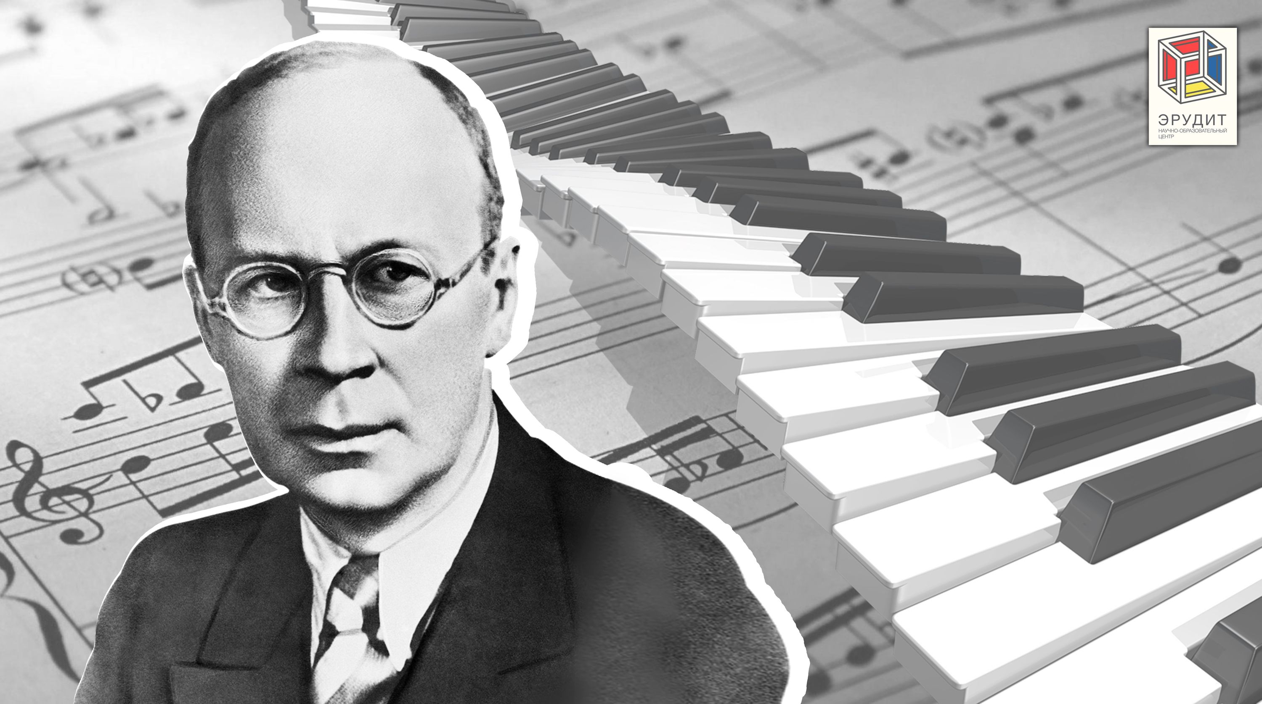
«His music is an explosion of emotions and energy» /Sviatoslav Richter/

