Slide 1
Christmas in Russia and in England
Автор:
Гнездилова Екатерина,
обучающаяся 3 Б класса
ОГБОУ «Новооскольская СОШ с УИОП»
Руководитель:
Гнездилова Любовь Алексеевна,
учитель иностранного языка
ОГБОУ «Новооскольская СОШ с УИОП»

Slide 2
Цель: сравнить обычаи и традиции празднования Рождества в Великобритании и России, выявить отличительные черты в проведении этого праздника, обнаружить общие корни и взаимосвязь между ними.
Задачи:
Изучить литературу, содержащую необходимые сведения по данной теме.
Выяснить историю происхождения Рождества.
Изучить особенности его празднования.
Сравнить символы и обычаи этого праздника в данных странах.

Slide 3
Гипотеза:
Данная гипотеза выбрана на основе того, что и православная и католическая церковь проповедует христианскую религию, одну из древнейших мировых религий. Предполагаю, что празднование Рождества Христова в России и Великобритании имеет общие черты, общие исторические корни.

Slide 4
Объект исследования– русская и британская культура
Предмет исследования - традиции и обычаи празднования Рождества Христова в России и Великобритании
Методы исследования
1. Поисковый
2.Исторический
3.Сравнительный

Slide 5
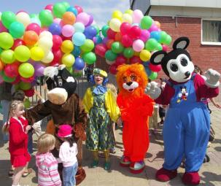
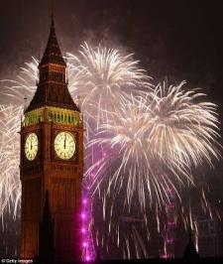
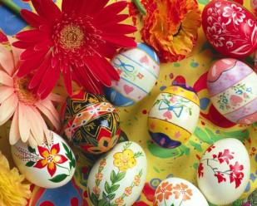
Праздники – неизменные спутники народной жизни
Государственные
Религиозные
Профессиональные
Календарные
Виды праздников
Неофициальные
Международные
Семейные
Детские

Slide 6
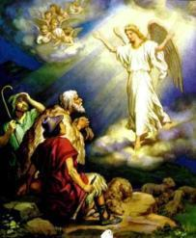
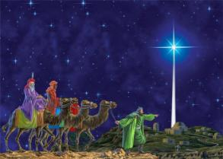
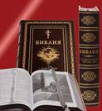
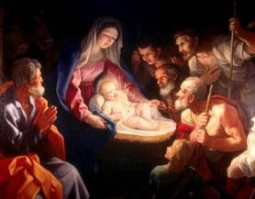
The origin of the holiday Christmas
An angel appeared to shepherds and told them that a Saviour had been born to Mary and Joseph in a stable in Bethlehem.
Three Wise Men of the East (the Magi) who followed a wondrous star, which led them to the new-born child.
They presented him gifts of gold, frankincense, and myrrh.

Slide 7
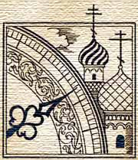
The date for celebrating Christmas
The date of Christmas on the 25th of December in the Gregorian calendar.
Russia celebrates Christmas On the 7th of January according to the old Julian calendar.

Slide 8
Christmas in Great Britain
For most British families, this is the most important festival of the year.

Slide 9
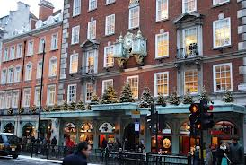
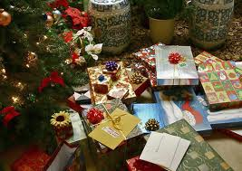
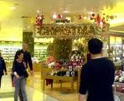
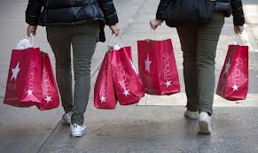
English people like this holiday very much and prepare for it beforehand. They buy presents for each other, try to send Christmas cards for their relatives and friends.

Slide 10
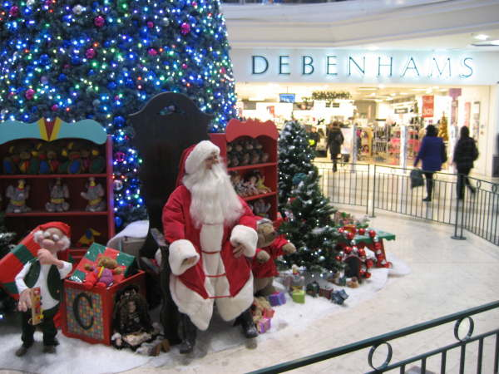
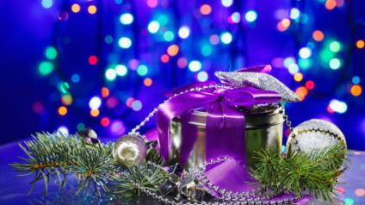
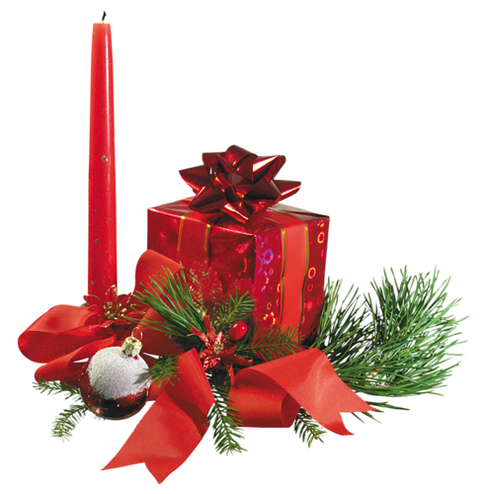
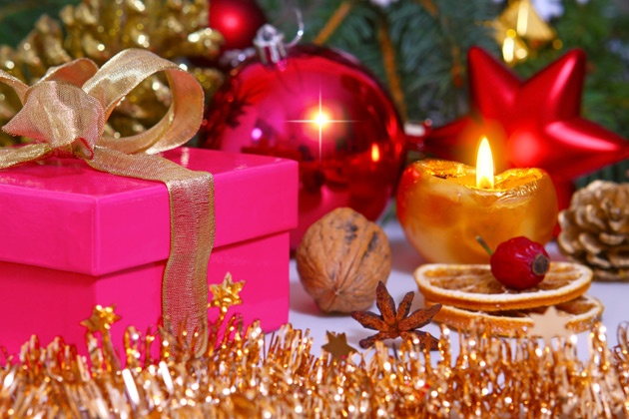

Slide 11
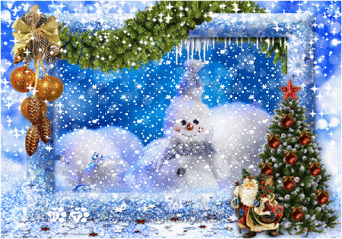

Slide 12
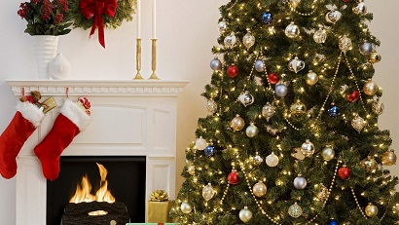
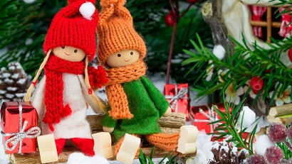
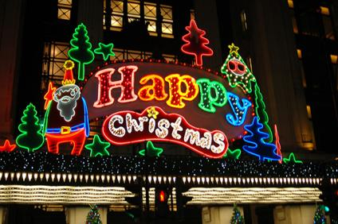
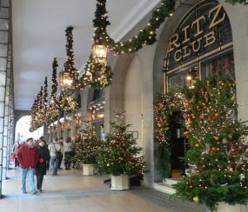
They decorate their houses in the traditional way. Christmas trees are set up in houses, in the streets and churches.

Slide 13
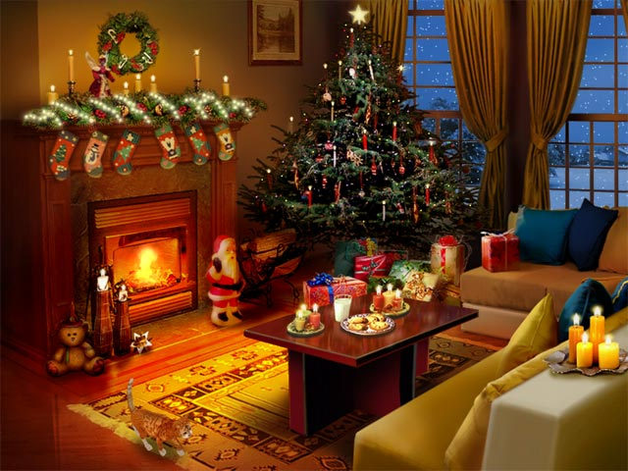
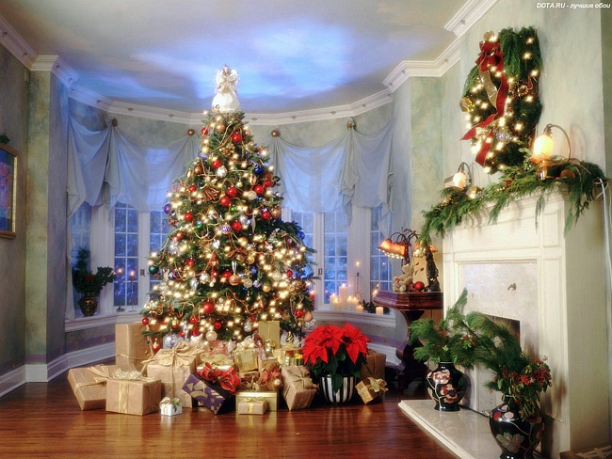

Slide 14
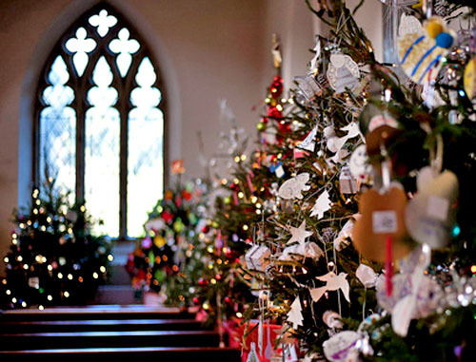
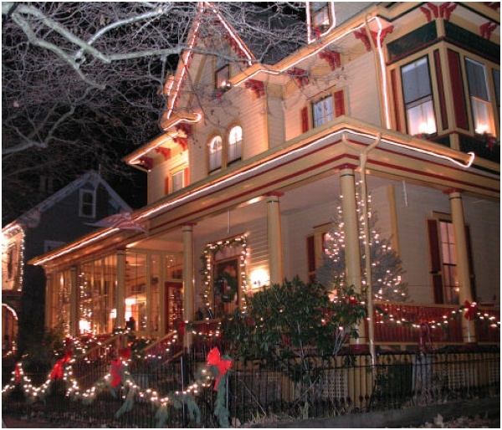
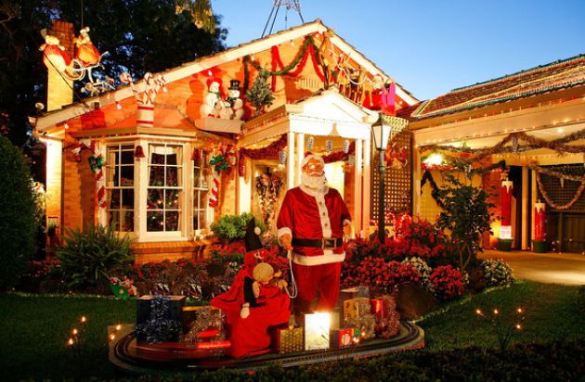

Slide 15
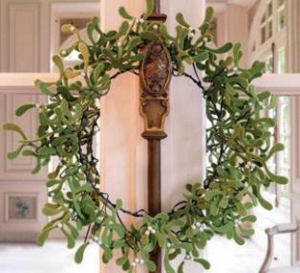
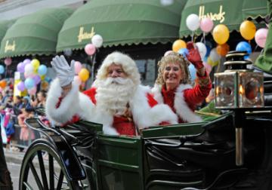
The symbols of Christmas

Slide 16
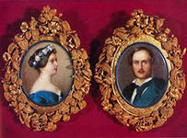
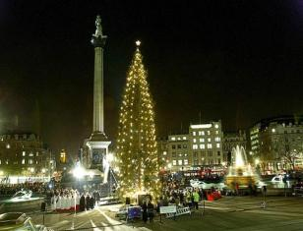
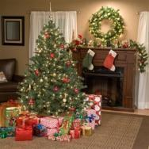
Queen Victoria and Prince Albert was the first decorated Christmas tree in Windsor castle in 1841.
In early December, the traditional Christmas tree with a height of 20 meters is installed in Trafalgar square.
Christmas tree

Slide 17
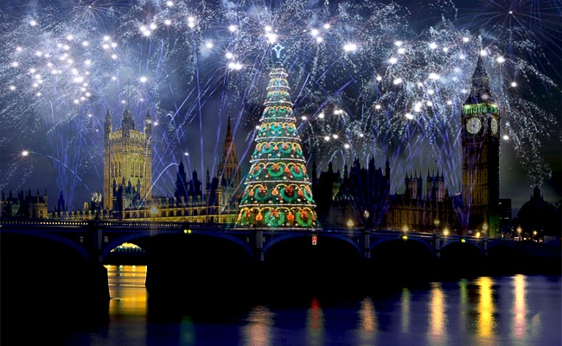
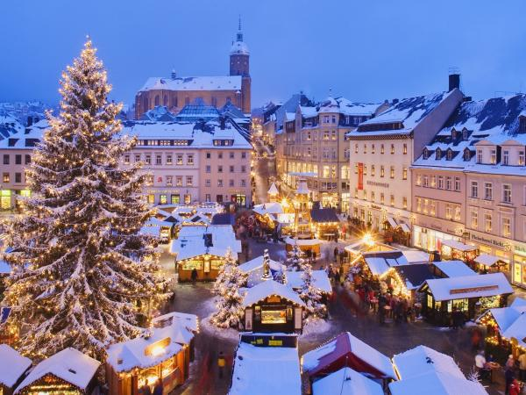

Slide 18
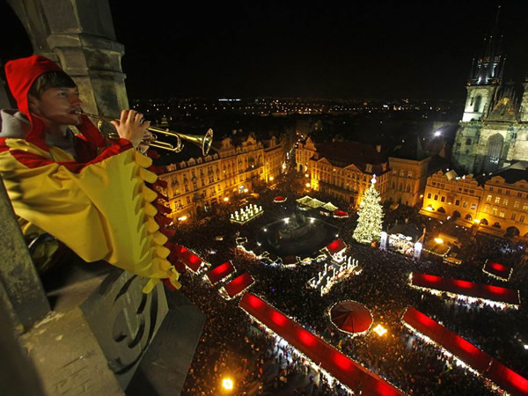

Slide 19
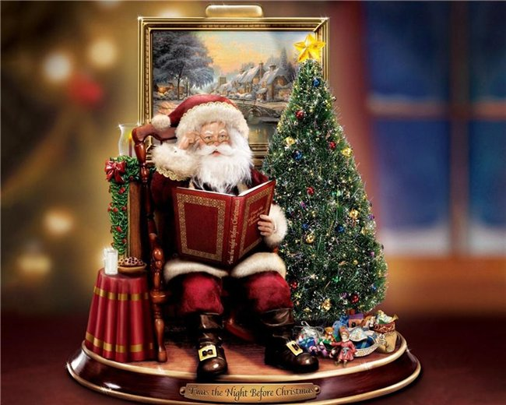
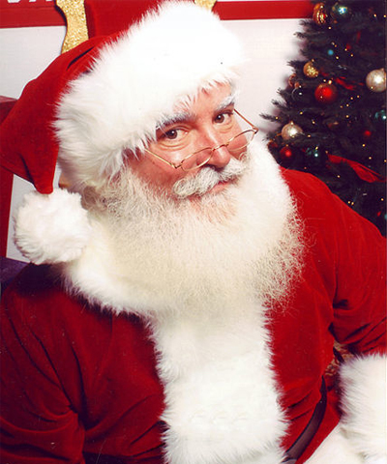
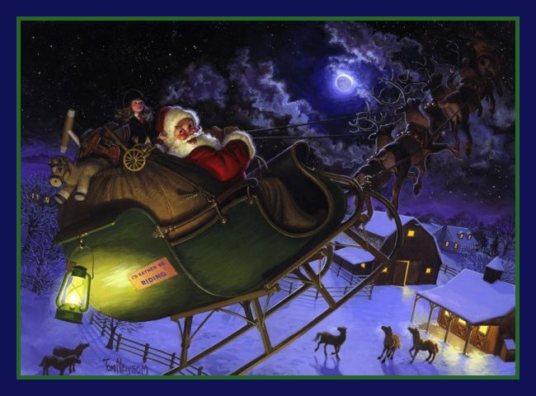
Santa Claus

Slide 20
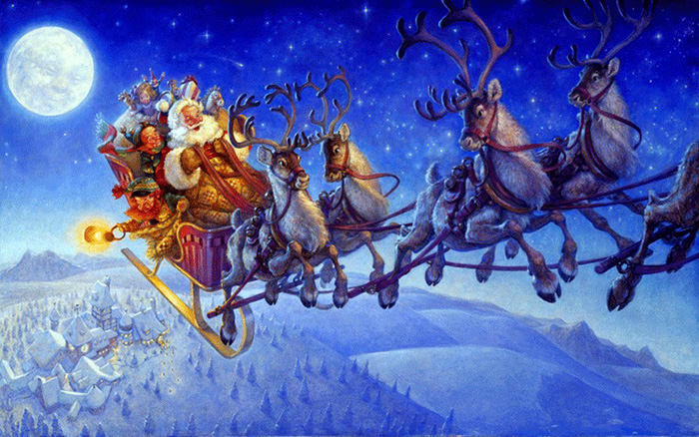
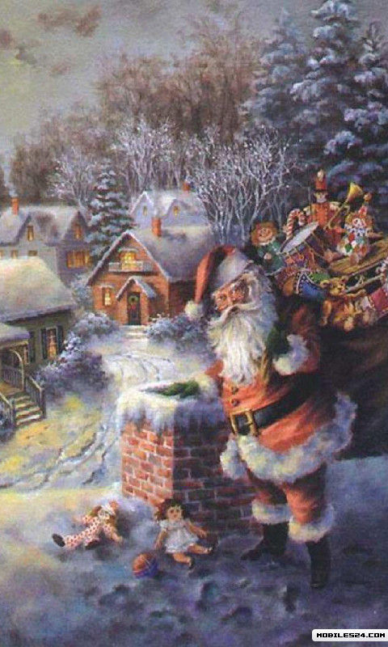
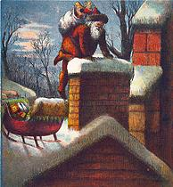
«Santa Claus traveled through the air and penetrated into the house through the chimney»

Slide 21
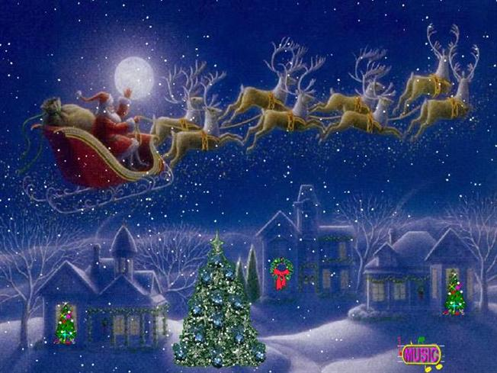

Slide 22
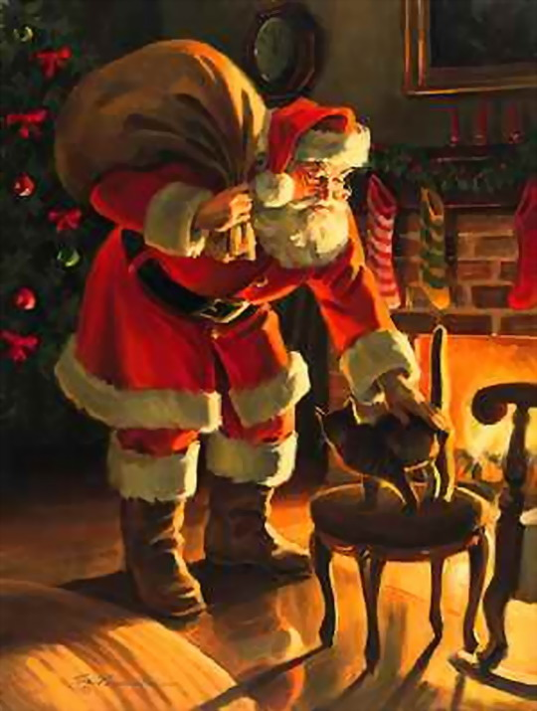
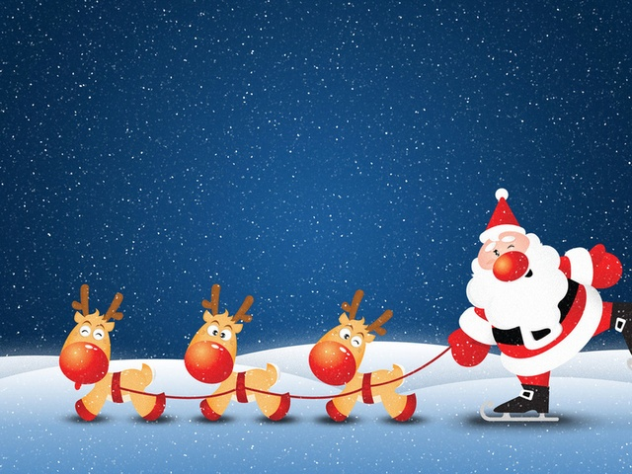
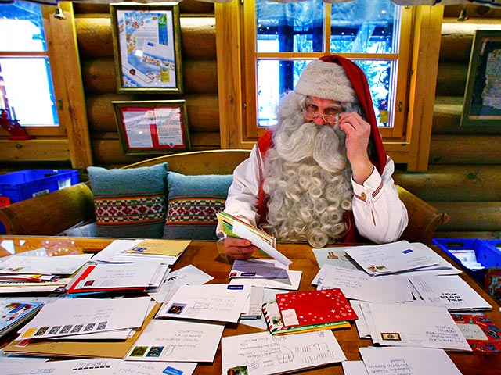

Slide 23
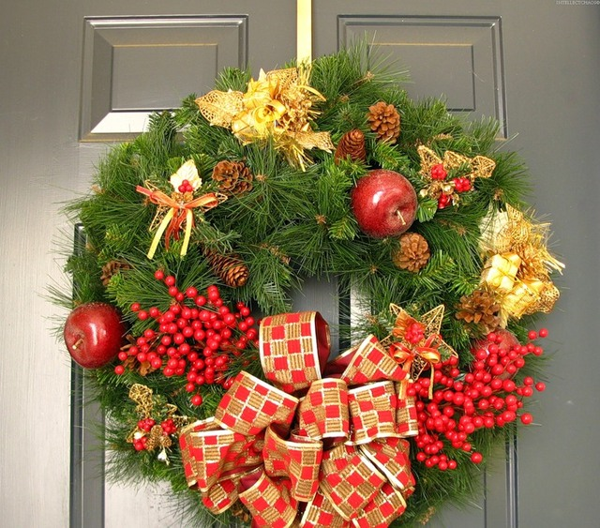
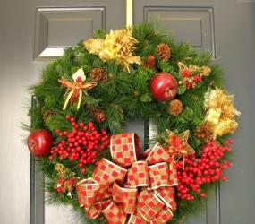
Mistletoe is another Christmas symbol. Sprigs of it are tied together with ribbons and hung up in doorways. By custom anyone standing under the mistletoe gets to be kissed.

Slide 24
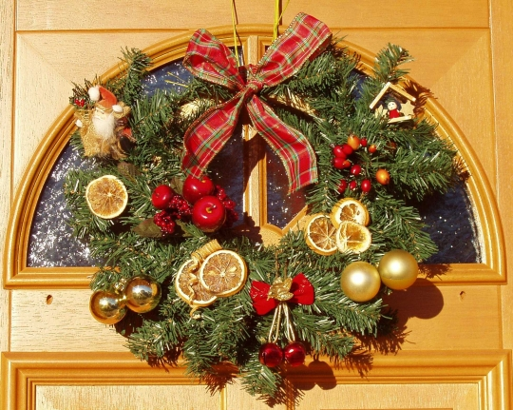

Slide 25
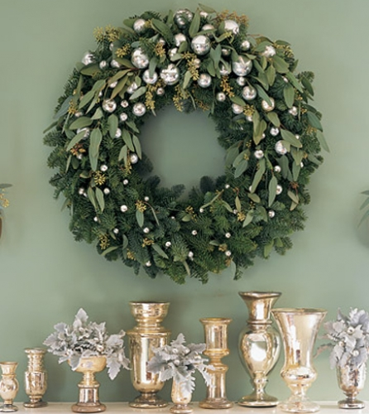
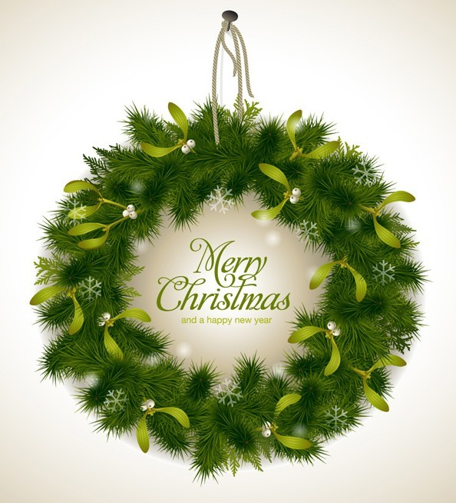
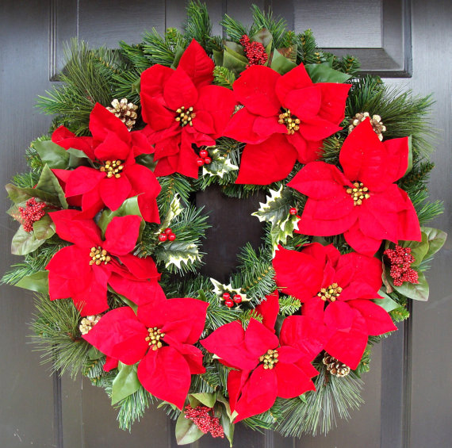

Slide 26
Holly is a bush with shiny red berries and glossy leaves with a characteristic shape and sharp pointy edges.

Slide 28
Christmas Socks

Slide 29
On the eve of Christmas children hang their stockings, so that Santa Claus could put presents into them: oranges, sweets, nuts and if the child didn't behave properly Santa Claus can put there a piece of coal as punishment.

Slide 30
Cookies for Santa

Slide 31
Christmas Lunch

Slide 32
A typical Christmas lunch includes turkey with cranberry sauce and pudding. Every young woman in each household helps to stir the Christmas pudding, if she wishes to be married that year. Usually a coin or two are hidden inside the pudding and part of the fun is to see who finds it.

Slide 33
In the afternoon they may watch the Queen on the television as she delivers her traditional Christmas message to the United Kingdom and Commonwealth.

Slide 34
Christmas in Russia
Christmas is one of the most cherished and long-awaited holidays in Russia.

Slide 35
Unlike many other countries it’s celebrated on the 7th of January, in accordance with the Orthodox calendar. Initially this day was linked with many folk customs.

Slide 37
On this day, many people attend a church service.

Slide 39
The symbols of Christmas

Slide 40
Since the 19th century appeared Christmas bazaars.

Slide 41
In 1935 tree again entered the Russian family.

Slide 43
In every home there is a New Year tree glittering with colored lights and decorations.

Slide 46
Father Frost

Slide 47
Children always wait for Father Frost to come and give them a present.

Slide 51
Some areas still keep up with the tradition of carols’ singing and masking on the night of January 6th.

Slide 53
Christmas Lunch

Slide 54
Traditional meal for Christmas in Russia is kutya. It’s sweet and delicious rice with raisins and dried.

Slide 55
The main meal on Christmas table included roasted pork and other meat dishes, such as goose with apples, roasted poultry, lamb, fish, etc. There were also pancakes, casseroles, pies with various fillings.

Slide 59
Similarities:
the history of the holiday is almost identical;
waiting for holiday: home decoration, festive table;
gifts are prepared in advance;
the celebration going fun, noisy, widely;
provides assistance to other, poorer people;
caroling;
mandatory presence of Christmas trees, candles, bells, Father Frost in Russia and Santa Claus in England.

Slide 60
Differences:
In the UK the main family holiday - Christmas in Russia – New year;
Christmas in England began on 25 December, in Russia - 7 January;
In England the new year is a continuation of the Christmas days, in Russia, on the contrary, Christmas is considered a continuation of the Christmas holidays;
In the UK, Christmas tree, adorn the streets before Christmas, and in Russia before the New year;
Special gifts and greetings , will set the table Britons are preparing for Christmas, in Russia for the New year;
Santa Claus lives in Lapland, comes with 8 reindeer, gift bags in stockings. Our Grandfather frost lives in Veliky Ustyug, arrives by three horses, gift bags under the tree;
On the table of the British main dishes are roast Turkey and pudding, on our table – salads, goose with apples, fish, jelly.

Slide 61
Спасибо за внимание!

