Slide 1
Презентация на тему:ОБЪЕДИНЕННОЕ КОРОЛЕВСТВО» 5 класс
Учитель английского языка 1 категории:Шейгасанова Л.Ш.

Slide 6
?
THE
RAPHYGEOG
FO HET
KU DAN SIT TICALPOLI LOOKOUT

Slide 7
THE GEOGRAPY OF THE UK AND ITS POLITICAL OUTLOOK

Slide 8
The LAND AND PEOPLE OF GREAT BRITAIN

Slide 10
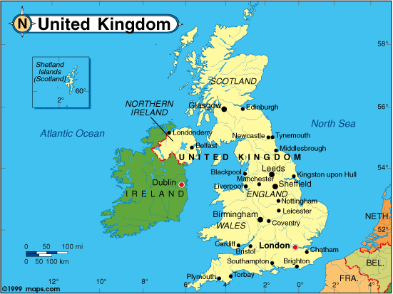

Slide 11
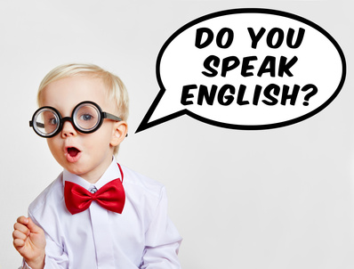

Slide 14
PLAN
Ex.5,6 p.4-5
Ex.9,10 p.18
Ex.15,16,17 p.10

Slide 15
Plan
1. Revise phrases of likes/dislikes/weather.
2 Role-play the dialogues
3 Write lexical dictation
4 Brush up knowledge of Grammar rule
(« Article with geographical names»).
5 Read the text to get more information about the country.
6 Retell the text

Slide 16
LET US REWIEW!

Slide 18
Ex.5,6 p.4-5
SOCIAL ENGLISH
DIALOGUES

Slide 20
Ex.9,10 p.18-19
SOCIAL ENGLISH
DIALOGUES

Slide 22
1 SHORT ANSWERS
So+ сказуемое+подлежащее
Be в настоящем am,is,are
Be в прошедшем was/were
Have/has/can-надо повторить
Настоящее простое do/does
Прошедшее простое did
Будущее простое will

Slide 23
SHORT ANSWERS
So+ сказуемое+подлежащее
Be в настоящем-?
Be в прошедшем-?
Have/has/can-?
Настоящее простое-?
Прошедшее простое-?
Будущее простое -?

Slide 24
SHORT ANSWERS
So+ сказуемое+подлежащее
1 I am a pupil.So… I
2 I like sweets.So… I
3 I have a dog.So… I
4 I can swim.So… I
5 I will fly to Moscow. So… I

Slide 25
SHORT ANSWERS
So+ сказуемое+подлежащее
1 I am a pupil.So am I
2 I like sweets.So do I
3 I have a dog.So have I
4 I can swim.So can I
5 I will fly to Moscow. So will I

Slide 26
YOUR MARK!
5 POINTS=5(EXCELLENT)
4 POINTS=4(GOOD)
3 POINTS=3(SATIS)
2 POINTS=2(POOR)

Slide 28
ex.15 p.10
[ju:,naitid ‘kiŋdəm]
...

Slide 29
are used with the definite article.
cities
seas
countries
an island
rivers
oceans
nations…
groups of islands
mountain ranges
official names of states
continents

Slide 30
are used with the definite article.
cities
seas
countries
an island
rivers
groups of islands
mountain ranges
official names of states
continents
oceans
nations…

Slide 31
Correct the mistakes
1 The Scotland
2 Union Jack
3 Atlantic Ocean
4 Irish Republic
5 The Belfast

Slide 32
LET’S CHECK
1 - Scotland
2 The Union Jack
3 The Atlantic Ocean
4 The Irish Republic
5 - Belfast

Slide 33
YOUR MARK!
5 POINTS=5(EXCELLENT)
4 POINTS=4(GOOD)
3 POINTS=3(SATIS)
2 POINTS=2(POOR)

Slide 34
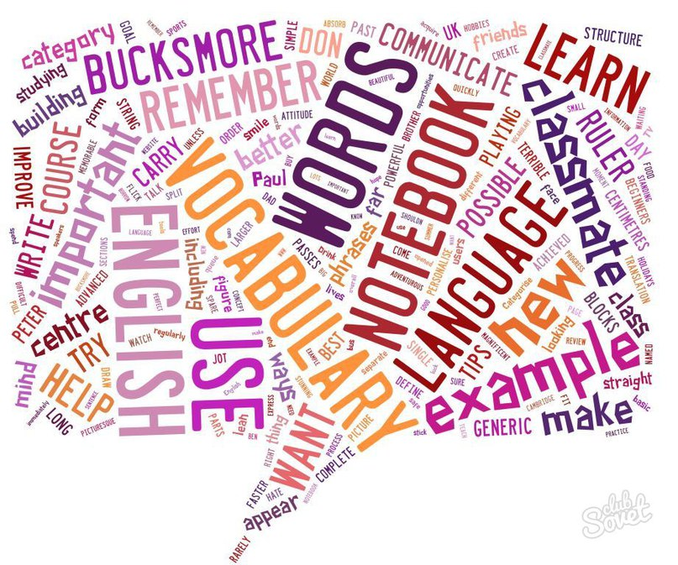

Slide 35
kingdom[‘kindem]
state[steit]
sign[sain]
industry[‘indestri]
Industrial[in’d∆striel]
saint[seint]
consist of [ken’sist ev]
surprise[se’praiz]
to be surprised of
lonely[‘lounli]
careful[‘keэful]
careless[‘keэlis]
carefully[‘keэfuli]
carelessly[‘keэlisli]
especially[I’spe∫li]

Slide 36
kindom
steit
siagn
industri
Indastrial

Slide 37
kingdom[‘kindem]
state[steit]
sign[sain]
industry[‘indestri]
Industrial[in’d∆striel]
saint[seint]
consist of [ken’sist ev]
surprise[se’praiz]
to be surprised of
lonely[‘lounli]
careful[‘keэful]
careless[‘keэlis]
carefully[‘keэfuli]
carelessly[‘keэlisli]
especially[I’spe∫li]

Slide 38
YOUR MARK!
5 POINTS=5(EXCELLENT)
4 POINTS=4(GOOD)
3 POINTS=3(SATIS)
2 POINTS=2(POOR)

Slide 39
1.What is the official name of the country?
2.How many parts are there in the UK?
3.Name all of them and their capitals.Can you show them on the map?
4. What is the UK washed by?
5.What separates Great Britain and Ireland?
6.What separates Great Britain and Europe?
7 How many people live in Britain?
8 What are big industrial cities?
9 What is the flag of the UK?
10 What is it made up?

Slide 40
Правила работы в паре
Помните:
-Вместе вы сможете сделать быстрее, чем каждый по отдельности.
-Работать должен каждый на общий результат.
-Распределите обязанности, если задание письменное.
- Старайтесь работать тихо, не мешая другим.

Slide 41
Country | Capital | People | Language
1 The UK
2 England
3 Scotland
4 Wales
5 Northern Ireland

Slide 42
Country | Capital | People | Language
1 The UK | London | The BritishScottish/ | English
2 England | London | The English | English
3 Scotland | Edinburgh | The Scots | Scottisn/English
4 Wales | Cardif | The Welsh | Welsh/English
5 Northern Ireland | Belfast | The Irish | Irish/English

Slide 43
The capital of страна…is…столица
The…национальность live there
The…национальность speak…язык

Slide 44
PLAN
1 GEOGRAPHICAL POSITION
2 PEOPLE
3 LANGUAGES
4 THE FLAG

Slide 45
We have +V3/Ved

Slide 46
Plan
1. Revise phrases of likes/dislikes/weather.
2 Role-play the dialogues
3 Write lexical dictation
4 Brush up knowledge of Grammar rule
(« Article with geographical names»).
5 Read the text to get more information about the country.
6 Retell the text

Slide 51
Презентация 10 слайдов про UK с рассказом 10-15 предложений

