Slide 1
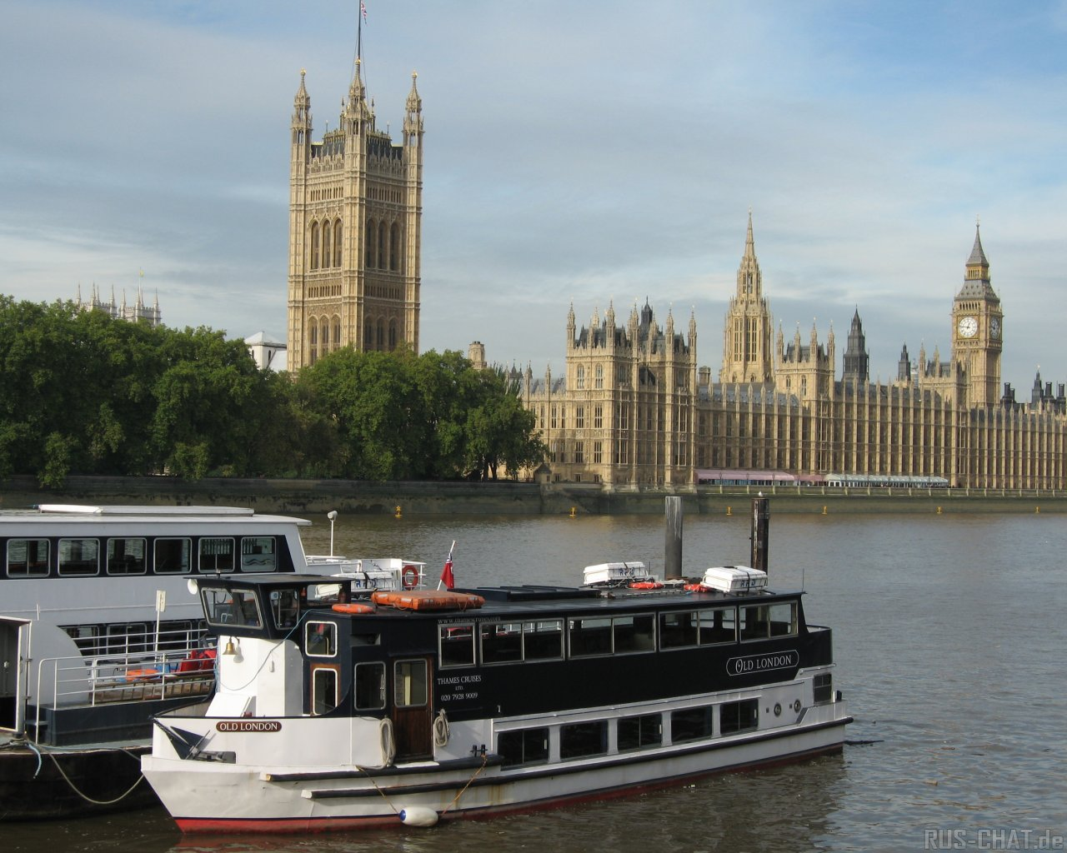
Travelling to London

Slide 2

Read the letter and say what topic we are going to discuss.
Dear friends,
I hope you are well. I am fine.
Soon, summer holidays will start. And I have some news for you. I would like to invite you to London in July. I hope you will accept my invitation and spend a good time visiting a lot of interesting places of interest.
Write me soon.
Your pen-friend,
Jess

Slide 3
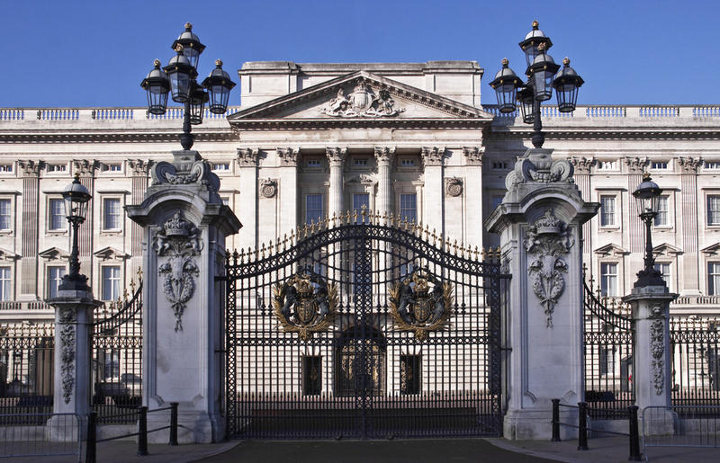
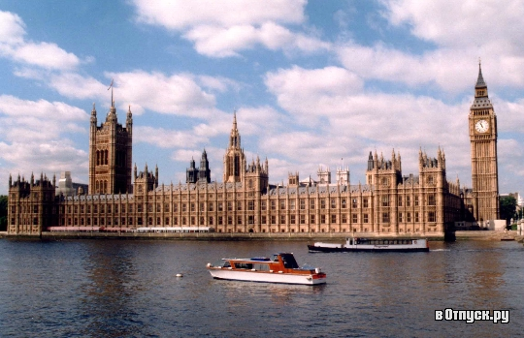
Look at these pictures. Name the places of interest, which you’ve seen watching the video about London.
Trafalgar Square
Buckingham Palace
The British Museum
The Houses of Parliament
The Tower of London
Westminster Abbey

Slide 4
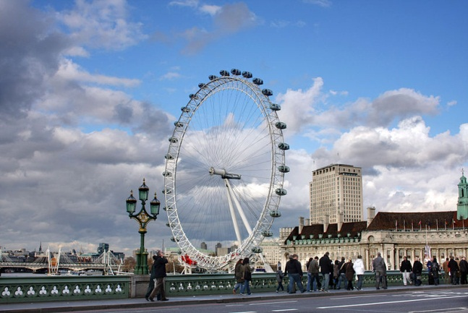
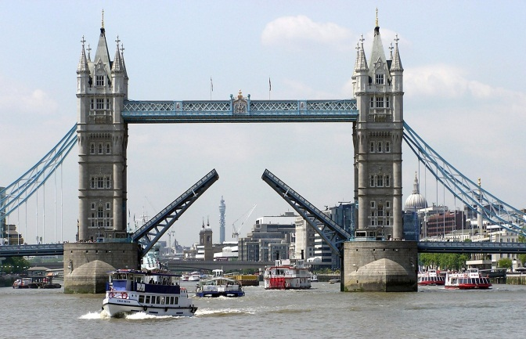
Look at these pictures. Name the places of interest,
which you’ve seen watching the video about London.
Piccadilly Circus
Trafalgar Square
The London Eye
Tower Bridge
The Tower of London
The River Thames

Slide 5
Work in pairs. Make up a dialogue.
Hello! We’d like to visit the Tower.
How can we get there?
Hello! I’m your guide. I’ll show you around London today. Where would you like to go first?
1
Thank you very much.
OK. It’s far from here.
You can get there by bus. I hope you’ll enjoy your travelling.
You are welcome.Have a nice day.

Slide 6
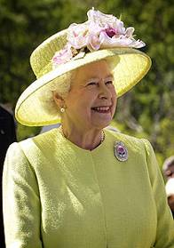
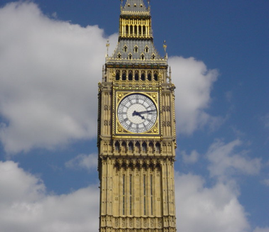
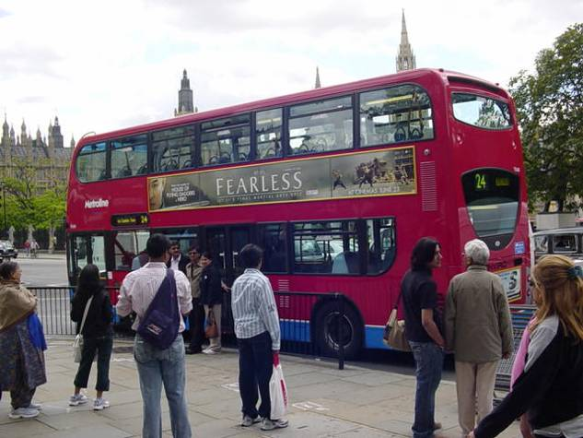
Choose the correct answer, using
Present Simple Tense
The Queen of Great Britain … in Buckingham Palace.
a) live b) lives c) is living d) will live
Big Ben is a famous clock. It … a deep tone and you can hear it every hour.
a) have b) has c) is having d) will have
A lot of people in London … by a double decker bus.
a) go b) goes c) are going d) will go

Slide 7
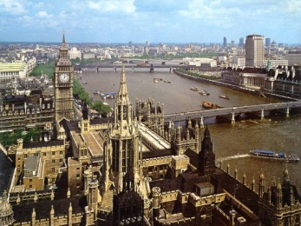
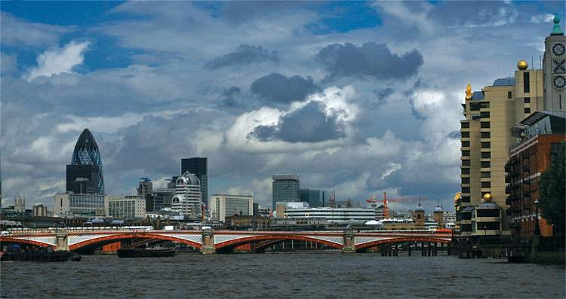
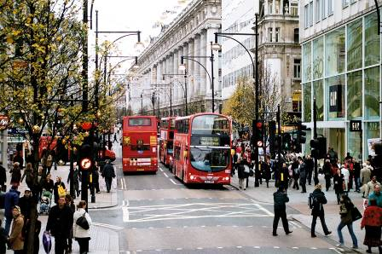
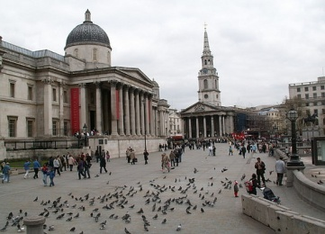
There … lots of places to visit in London.
are b) is c) am d) will be
Every year my friend … to London.
a) go b) goes c) will go d) is going
Some tourists usually … a lot of souvenirs in Oxford Street.
a) buy b) buys c) is buying d) bought
I … to visit Trafalgar Square.
a) like b) liked c) likes d) will like

Slide 8
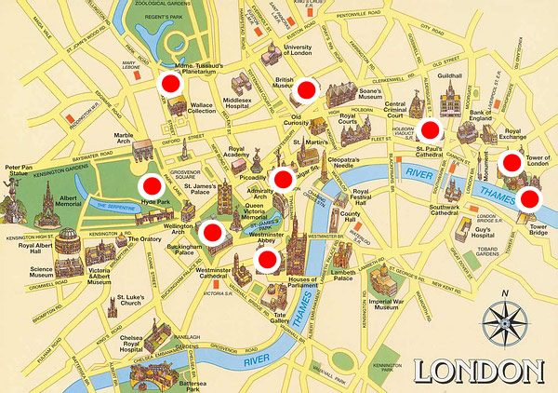
WELCOME TO LONDON
Give a talk on London.
Remember to discuss:
what imagine when you think of London
why people travel to London
what places in London you would like to visit

Slide 9

What river does London stand on?
a) The Thames
c)The Trent
b) The Potomac
d) The Severn

Slide 10
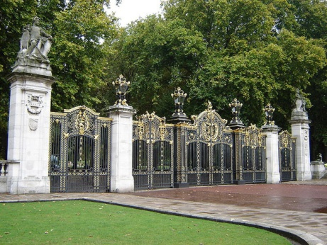
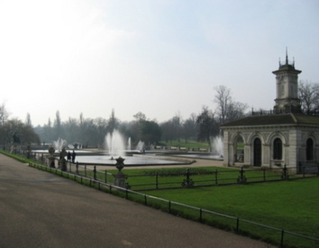
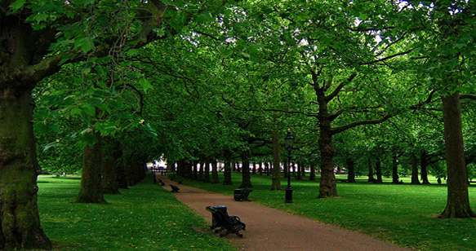
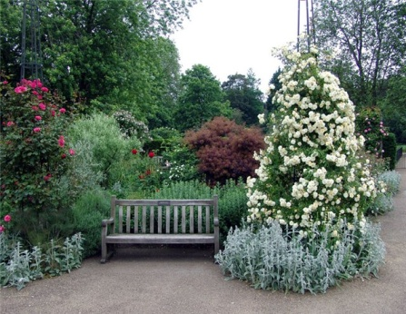
What is the largest park in London?
a) Green Park
c) Hyde Park
b) St. James Park
d) Regent’s Park

Slide 11
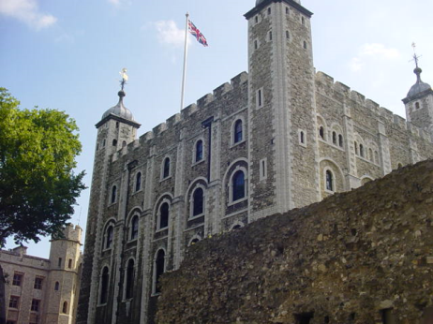
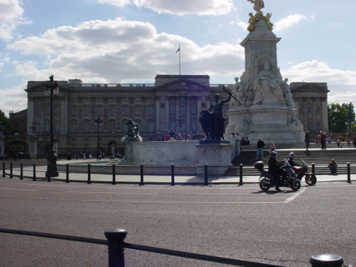
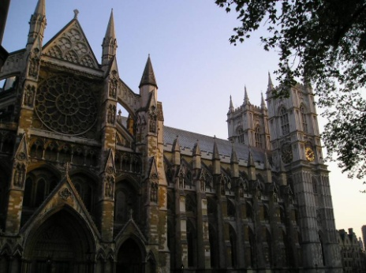
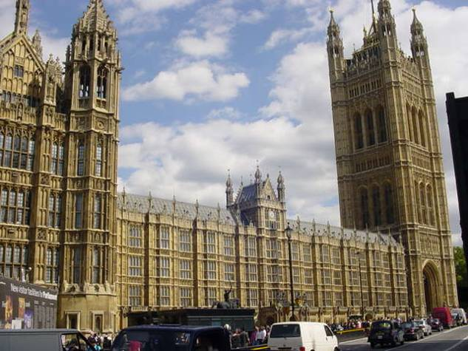
Where does the monarch of Great Britain live?
a) The Tower of London
c) Buckingham Palace
b) Westminster Abbey
d) The Houses of
Parliament

Slide 12

Write a letter to Stephen Wooding about your decision to visit London
Домашнее задание: напишите письмо о вашем решении посетить Лондон.

Slide 13


I liked the lesson, I can tell about London
I liked the lesson, but I can’t tell about
London

